Slide 1

COVID 19 LABORATORY DATA ANALYSIS
Sowmya K

Slide 2

TOPICS TO COVER
Introduction
How did AI and ML help COVID-19
Problem Statement
Dataset Explanation
Data Preparation
Exploratory Data Analysis
Clustering Methods Used
Comparision of the Methods
How does this help in Life Care Practices

Slide 3

Introduction
The severe acute respiratory syndrome coronavirus 2 (SARS-CoV-2) is the culprit behind COVID-19, a contagious respiratory disease. The global pandemic was caused by it when it was first discovered in Wuhan, China, in December 2019. Millions of fatalities globally and severe economic and social upheaval have been brought on by COVID-19, which has had a huge influence on public health. In addition to ongoing research on therapies, COVID-19 vaccines have been created to help prevent the illness.
Diagnostic laboratory testing for COVID-19 is a vital tool for locating those who have been exposed to the virus. The COVID-19 pandemic has made healthcare analytics even more crucial for controlling infectious illnesses. Healthcare experts may watch the virus's transmission, spot trends, and decide on appropriate public health actions by evaluating testing data.
The results of the testing may be used to pinpoint outbreaks, hotspots, and clusters of infections, enabling focused measures to stop the virus from spreading.
It can also help optimize testing strategies by identifying areas with the greatest need for testing and predicting the number of tests that will be required in the future.

Slide 4

How did AI and ML help COVID-19
The COVID-19 epidemic is being fought in several ways using AI and ML.
Diagnoses and early detection: By looking for certain patterns in CT and X-ray scans that point to the presence of the virus, AI systems can assist in the early diagnosis of COVID-19. Infected people can be swiftly isolated and treated because of this.
Contact tracing: By examining data from contact tracing apps and other sources, ML systems can be used to track the spread of COVID-19. Public health experts can use this information to find hotspots and take action to limit the illness.
Medication discovery & development: By analyzing a great amount of data from a variety of sources, such as medical publications and clinical trials, AI algorithms can assist researchers in finding viable medication candidates for COVID-19.
Vaccine development: By examining data from prior outbreaks and clinical trials, AI systems can assist researchers in identifying viable vaccine candidates. The formulations and dosages of vaccines may also be improved with their aid.
Hospitals and healthcare systems can use ML algorithms to improve resource allocation during the pandemic by identifying which patients need to be admitted and forecasting the availability of critical supplies.

Slide 5

Problem Statement
Analyze
Analyze the data and track the spread of the virus over time and identify states that may be particularly affected.
Identify
Identify patterns and trends in the test results and the impact of the virus on the population.
Compare
Comparing the COVID-19 outcomes and trends between different regions or countries to identify potential differences in public health policies and interventions.

Slide 6
How Clustering helps us to solve the problem?
In order to find patterns and groups among the cases based on several characteristics including demographics, symptoms, laboratory results, and outcomes, time clustering may be utilized on the COVID-19 data. It can offer insights into the spread and severity of the disease within certain groups or geographic areas.
Clustering can also be used to spot outliers or uncommon situations that could call for more research or treatment.

Slide 7
Dataset
Covid-19:https://healthdata.gov/dataset/COVID-19-Diagnostic-Laboratory- Testing-PCR-Testing/j8mb-icvb

Slide 8

Dataset Explanation
State: Refers to the two-letter abbreviation of the state where the COVID-19 testing was conducted or reported.
State_name: Refers to the full name of the state where the COVID-19 testing was conducted or reported.
State_fips: Refers to the Federal Information Processing Standard (FIPS) code for the state where the COVID-19 testing was conducted or reported. The FIPS code is a five-digit code that uniquely identifies each state and county in the United States.
fema_region: Refers to the FEMA (Federal Emergency Management Agency) region in which the state where the COVID-19 testing was conducted or reported is located. The FEMA regions are used to coordinate emergency response efforts across the United States.

Slide 9
Dataset Explanation
overall_outcome: Refers to the result of the COVID-19 test, which can be positive, negative, or inconclusive.
date: Refers to the date on which the COVID-19 testing was conducted or reported.
new_results_reported: Refers to the number of new COVID-19 test results reported on a particular date.
total_results_reported: Refers to the cumulative total number of COVID-19 test results reported up to a particular date.
geocoded_state: Refers to the state where the COVID-19 testing was conducted or reported, as determined by geocoding the location where the test was conducted or reported.

Slide 10
Data Preparation
CHECK FOR MISSING DATA
HANDLING OUTLIERS
CORRELATIONS

Slide 11
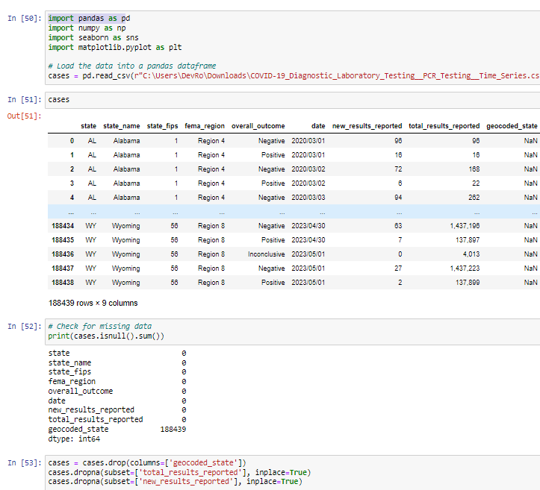
CHECK FOR MISSING DATA
The geocoded_state column had 188,439 missing values, which is a significant portion of the dataset. Therefore, it was dropped from the data frame using the drop method.

Slide 12
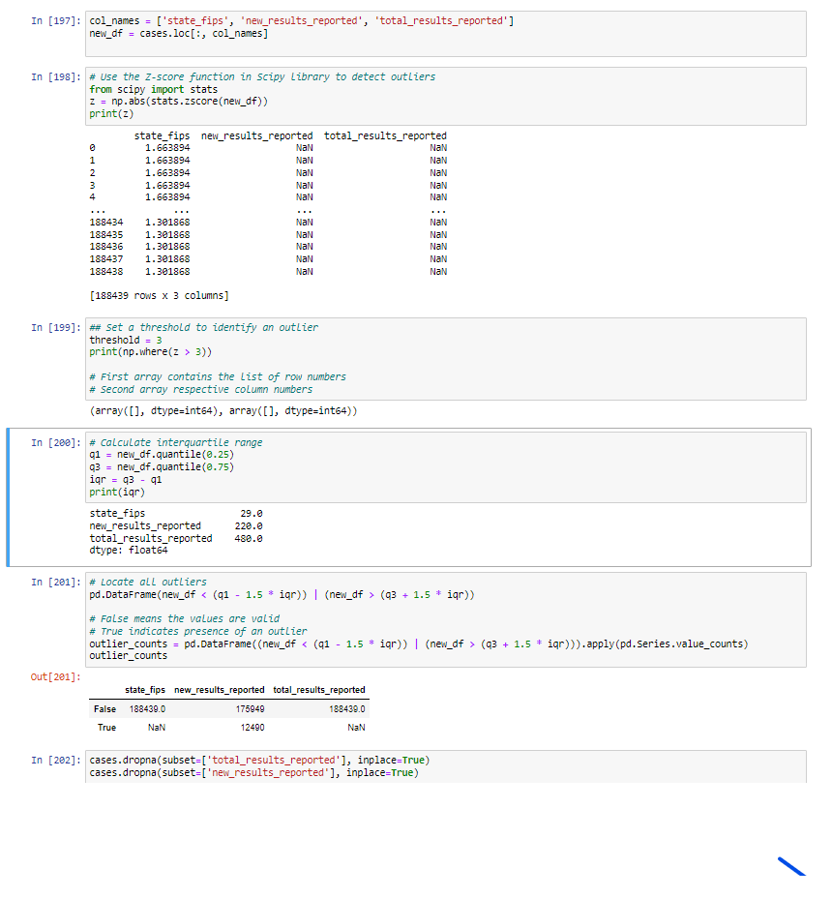
HANDLING OUTLIERS
This output indicates that there are no missing values (NaN) in the state_fips and total_results_reported columns, but there are 12,490 missing values in the new_results_reported column. The True values in the second row indicate the presence of missing values in the respective columns.
The dropna method was used on the total_results_reported and new_results_reported columns to remove any rows that had missing values in these columns. This was done because these columns are critical to the analysis and modeling of the data, and having missing values in these columns could lead to inaccurate results.

Slide 13
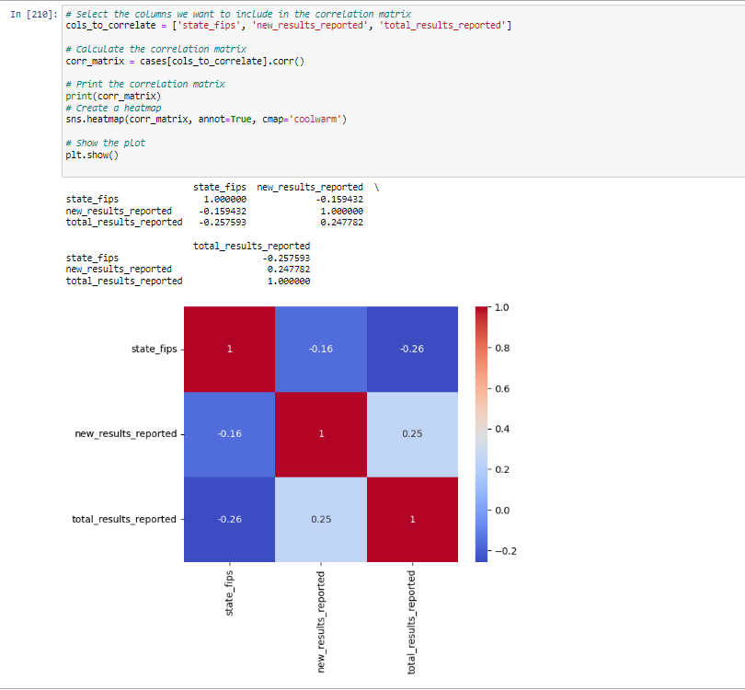
CORRELATIONS
The correlation coefficient measures the strength and direction of the linear relationship between two variables.
A correlation coefficient can range from -1 to +1, where -1 indicates a perfect negative correlation, 0 indicates no correlation, and +1 indicates a perfect positive correlation.
we can see that there is a weak positive correlation between new_results_reported and total_results_reported, indicating that as the value of new_results_reported increases, the value of total_results_reported tends to increase slightly as well.

Slide 14

Exploratory Data Analysis
HISTOGRAMS
SUMMARY STATISTICS
BOXPLOTS

Slide 15
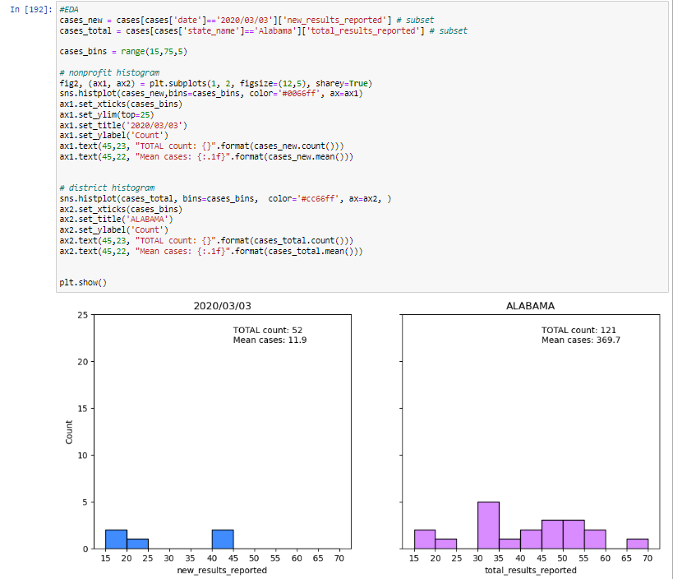
HISTOGRAMS:
This code generates two histograms using Seaborn library based on two subsets of data from the 'cases' dataframe:
Subset of data where the date is '2020/03/03', focusing on the 'new_results_reported' column.
Subset of data where the state name is 'Alabama', focusing on the 'total_results_reported' column.
The first histogram on the left shows the distribution of the number of new COVID-19 cases reported on March 3rd, 2020, while the second histogram on the right shows the distribution of the total number of reported COVID-19 cases in Alabama.

Slide 16
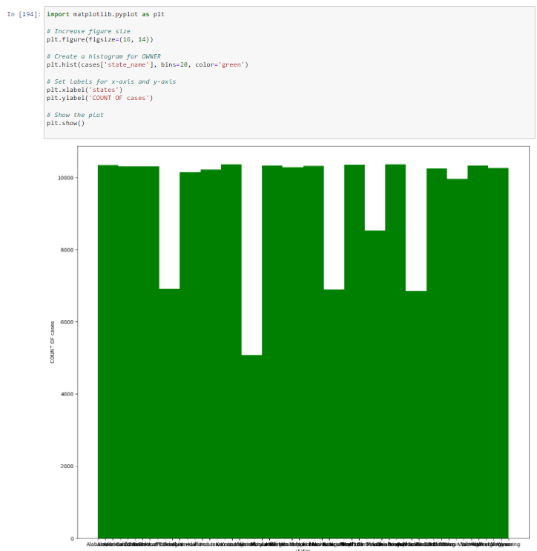
Histogram showing count of cases for each state

Slide 17
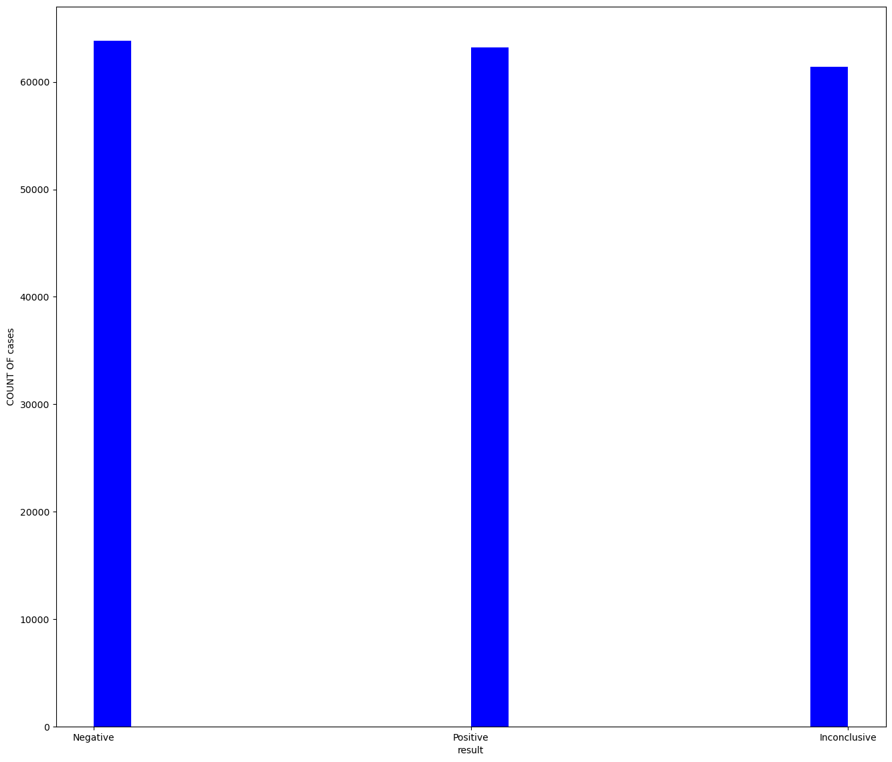
HISTOGRAM SHOWING POSITIVE, NEGATIVE AND INCONCLUSIVE CASES

Slide 18

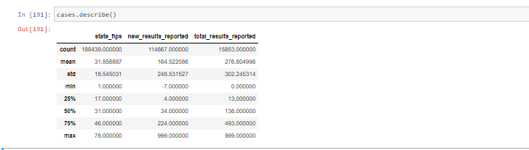
Summary statistics
These are the statistics for New_results_reported and total_results_reported

Slide 19
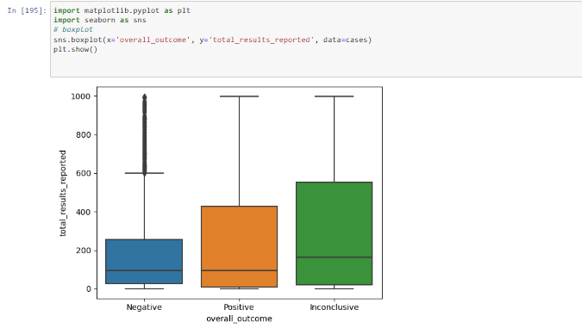
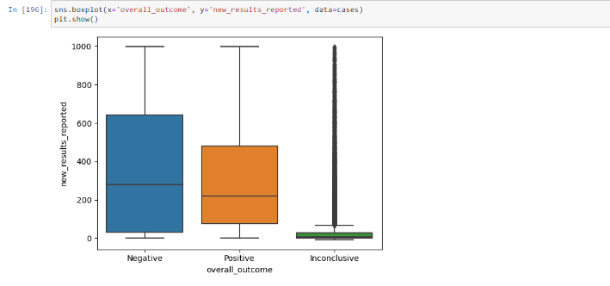
BOXPLOTS
These figures show the box plots for new_results_reported and total_results_reported

Slide 20
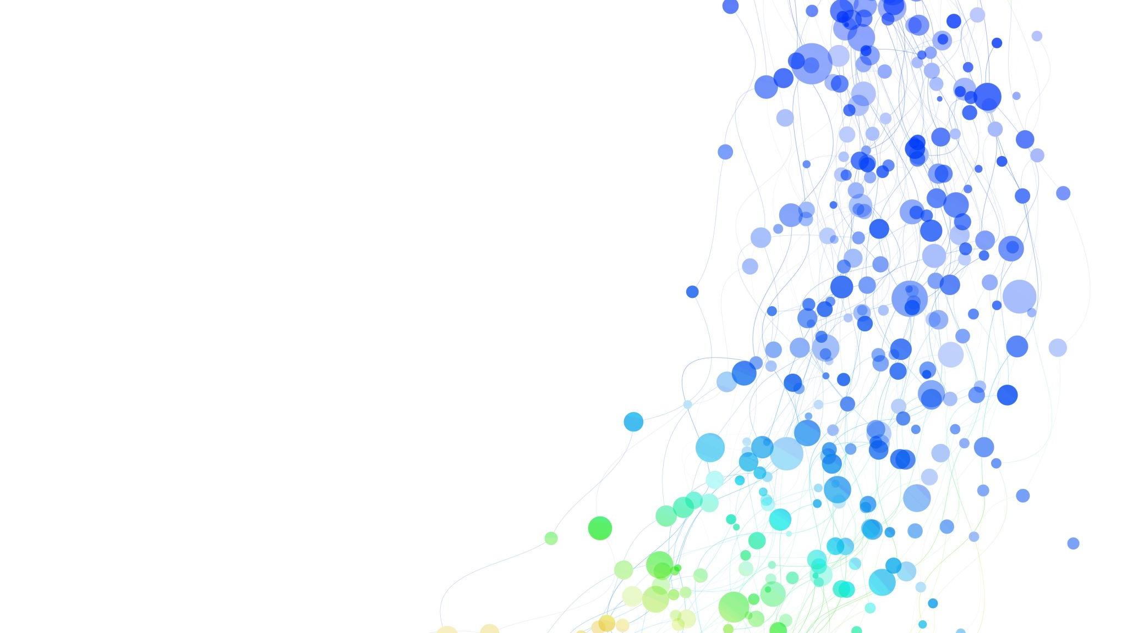
Clustering Methods Used
Clustering with K-means-Elbow Method: The "elbow method" is a way for figuring out how many clusters in K-means clustering are best.
Density-Based Spatial Clustering of Applications with Noise is known as DBSCAN. It is a clustering method that differentiates sparsely populated regions from high-density regions by grouping nearby points together in those regions. Clusters are defined by DBSCAN as contiguous high-density point regions that are divided by low-density point regions. Epsilon () and minimum points (minutes) are two of its crucial factors.

Slide 21
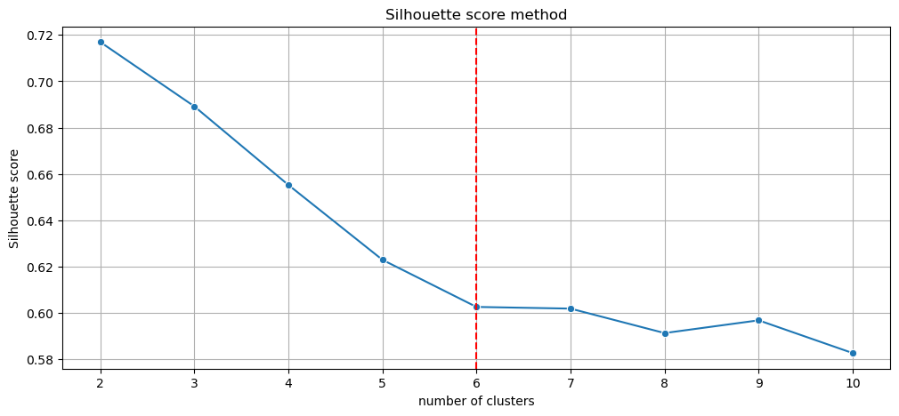
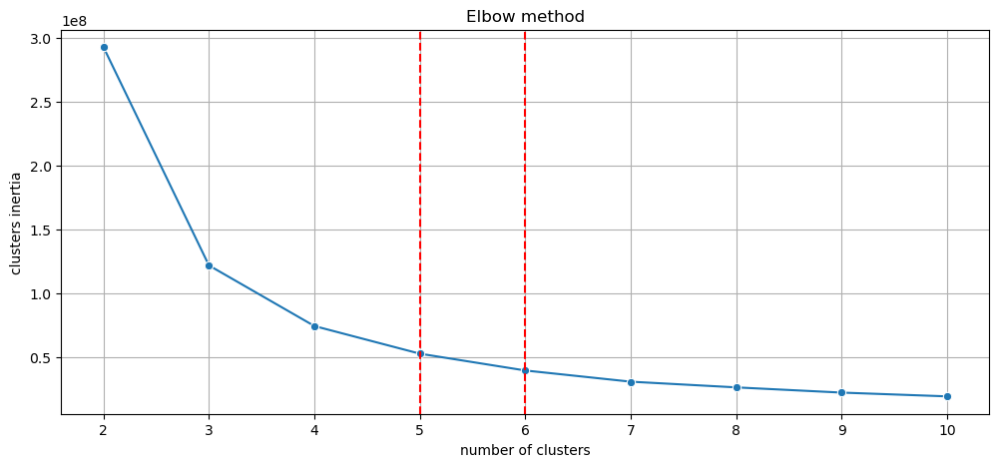
K-means-Elbow Method
A silhouette score of 0.62 indicates that the clustering is fairly clear and well-separated. The score for a silhouette can vary from -1 to 1. While a score of -1 suggests that the data points are likely assigned to the incorrect clusters, a score of 1 indicates that the data points are clearly segregated and belong to their respective clusters. A score that is very near to zero means that the data points may overlap or may not be clearly attributed to any one cluster. In general, better-defined clusters are indicated by a higher silhouette score.

Slide 22
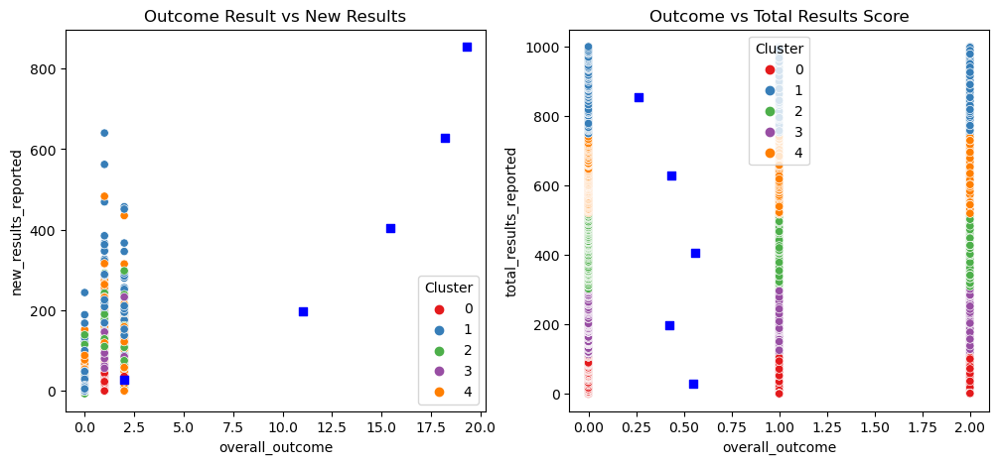
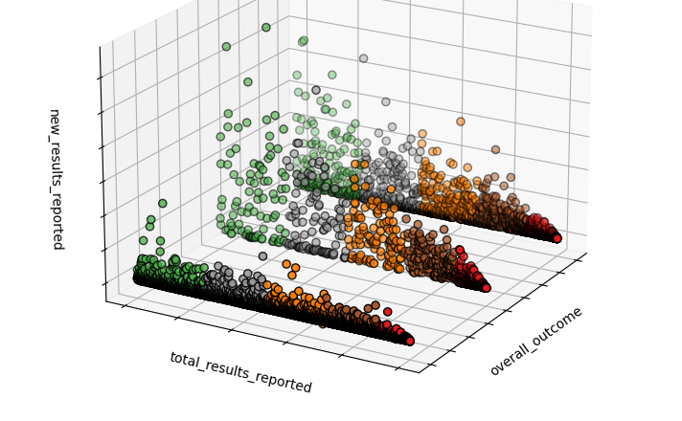
Outcome Result vs New Results Outcome Result vs Total Results (for k=5)
We used label encoding and assigned 0 for inconclusive,1 for Negative, and 2 for positive cases. Here we could see that there are more negative cases among the newly reported cases.
For the total reported cases all are similar.

Slide 23
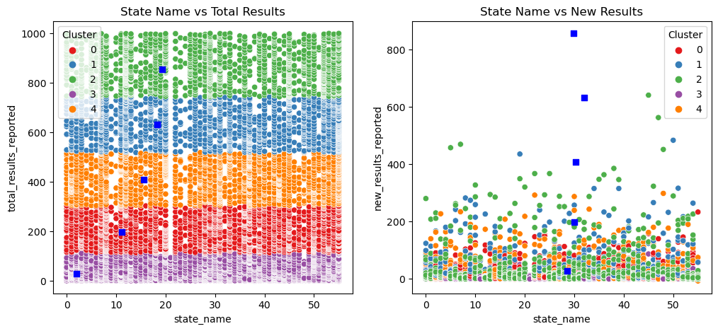
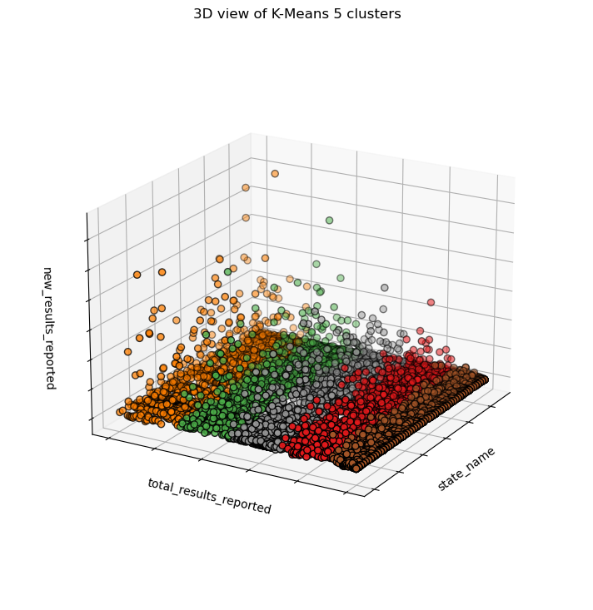
State Name vs New Results State Name vs Total Results (for k=5)
In the figure we could see the New Results and Total results for the respective states

Slide 24
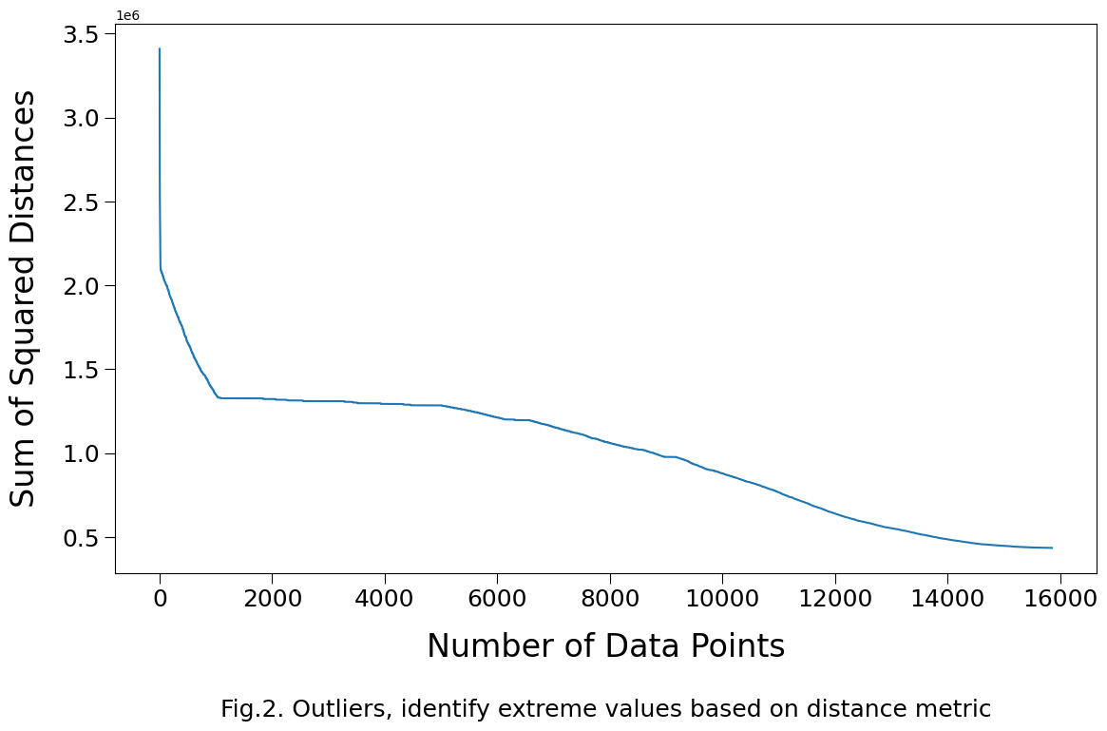
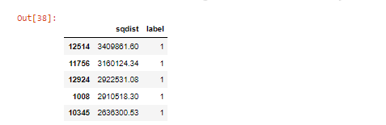
Outliers based on distance metric
These rows are 5 top outliers based on distance
The top outlier candidates appear to be in cluster 1 (blue dots in chart above)
Top outliers have the largest sum of squared distance values

Slide 25
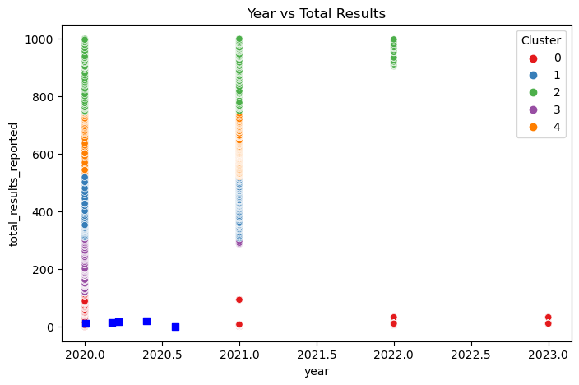
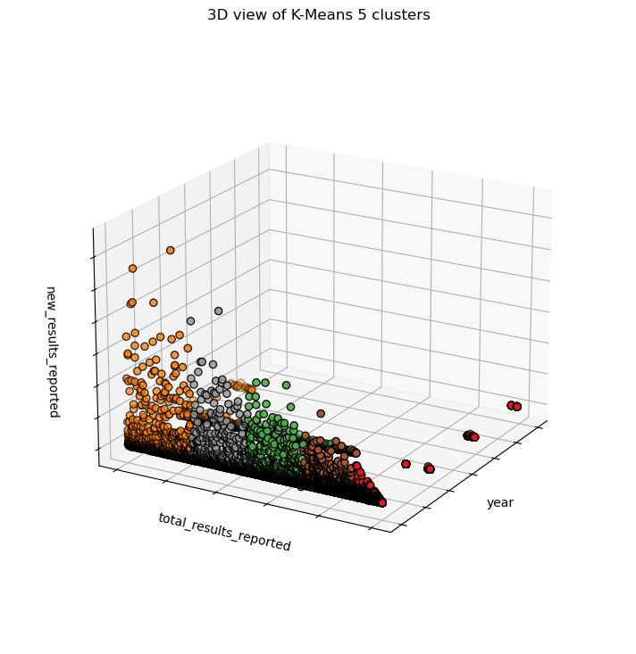
Year vs New Results Year vs Total Results (for k=5)
From the cluster ,we could see that there are more covid cases in 2020.

Slide 26
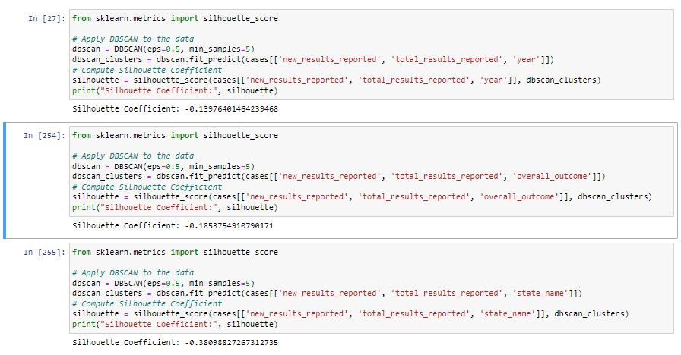
DBSCAN
A negative silhouette coefficient value indicates that the data points in a cluster are closer to neighboring clusters than to their own cluster. In other words, it implies that the clustering is not well-defined or the data points are poorly assigned to clusters. A value of -0.13976401464239468 suggests that the current clustering is not very good and needs to be improved.

Slide 27
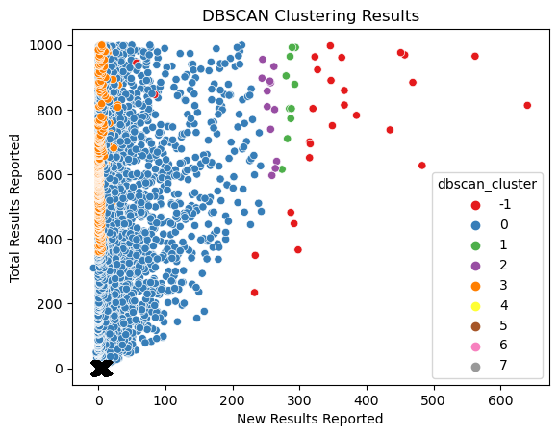
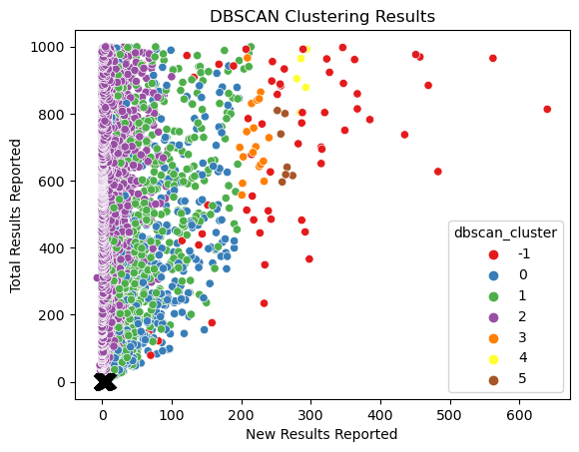
DBSCAN Clusters for Outcome Results and Test Results DBSCAN Clusters for Year and Test Results

Slide 28

Comparison of methods
K-means is successful for datasets with well-separated, spherical clusters, whereas DBSCAN is better suited for datasets with irregularly-shaped clusters and changing densities. As a result, in some instances, k-means clustering may be superior to DBSCAN when applied to COVID data. K-means can be helpful, for instance, if the clusters have well-separated, spherical forms and we have COVID data on different states or nations and we want to cluster them based on their COVID cases, fatalities, and vaccination rates. In well-separated clusters, each data point is closer to its assigned centroid than to any other centroid, which is why k-means assigns each data point to a single cluster.
On the other hand, DBSCAN may be more appropriate if we have COVID data on a highly populated city where the number of instances fluctuates significantly between different neighborhoods. This is due to the fact that DBSCAN can recognize clusters of various sizes and densities as well as manage noise points that might not be associated with any cluster.
In conclusion, the decision between k-means and DBSCAN is influenced by the dataset's clustering structure and density as well as the specific analysis's objectives.

Slide 29
How does this help in Life Care Practices
Targeted advertising: Clustering can be used to determine which population segments are more susceptible to COVID-19. Healthcare organizations can raise awareness and promote habits that help stop the spread of the virus by focusing their communications and educational initiatives on these populations.
Distribution of vaccines: Clustering can be used to pinpoint regions or populations that require vaccines the most. Healthcare organizations can make sure that vaccines are distributed effectively and fairly by giving priority to particular regions or populations.
In general, COVID-19 data clustering can assist in decision-making and enhance the efficacy of life-care procedures connected to the management and prevention of the virus's transmission.

Slide 30
Thank you

